Slide 1
Study about Continued Use of LinkedIn
Q5 How much do you agree with the following statements about LinkedIn usage? (7-point scale)
All things considered, it is likely that I will continue to use LinkedIn (1)
I value the information LinkedIn offers, with the help of which I get what I need in a certain situation (2)
Using LinkedIn helps me to feel accepted by others (3)
LinkedIn properly satisfies users’ needs (4)
LinkedIn is part of my everyday activity (5)
I would be upset if LinkedIn shut down (6)
I rely on LinkedIn when I have a specific information need (7)
LinkedIn provides convenient functions (8)
Using LinkedIn bores me (9)
How likely is a person to stop using LinkedIn?

Slide 2
Gradient Boosting: Feature importance
XGBoost | Feature importance
Q5_2 | 0.244268
Q5_3 | 0.085783
Q5_4 | 0.070811
Q5_5 | 0.271757
Q5_6 | 0.047562
Q5_7 | 0.05547
Q5_8 | 0.141423
Q5_9 | 0.082926
Random forest feature importance
0.221445
0.071668
0.114795
0.232877
0.064925
0.077191
0.139245
0.077854
Logit model coefficients
0.519509
0.063834
-0.08723
0.183154
-0.07961
-0.10728
0.225757
-0.00966
from xgboost import XGBClassifier
XGB_clf = XGBClassifier(n_estimators=200, learning_rate=0.5)
XGB_clf.fit(x_train, y_train)
print(XGB_clf.feature_importances_)

Slide 3
Value Prediction
Respondent | y_test | y_pred
1 | 1 | 0
2 | 1 | 0
3 | 1 | 1
4 | 0 | 0
5 | 1 | 0
6 | 0 | 1
7 | 0 | 0
8 | 1 | 1
9 | 0 | 0
10 | 0 | 0
11 | 1 | 1
12 | 0 | 0
13 | 0 | 1
14 | 0 | 1
15 | 0 | 0
16 | 1 | 1
17 | 0 | 1
18 | 1 | 1
19 | 0 | 0
20 | 0 | 1
21 | 1 | 0
22 | 0 | 0
23 | 0 | 0
y_pred=XGB_clf.predict(x_test)

Slide 4



Model Evaluation
$Sensitivity=\frac{True Positive}{True Positive+False Negative}$
$Specificity=\frac{True Negative}{True Negative+False Positive}$
 | Error rate | Sensitivity | Specificity | Precision | AUC | Cross-Entropy
XG Boost | 0.328571 | 0.676471 | 0.666667 | 0.657143 | 0.797386 | 0.897337
$Precision=\frac{True Positive}{True Positive+False Positive}$

Slide 5
Hyperparameter Optimization
How to decide the best hyperparameters? E.g., learning rate
Use hyperparameter search method
from xgboost import XGBClassifier
from skopt.space import Real, Integer
from skopt import BayesSearchCV
model = XGBClassifier()
space = {
'learning_rate': Real(0.01, 0.9),
'n_estimators' : Integer(20, 2000),
'max_depth' : Integer(1, 20),
'subsample' : Real(0.5, 1.0),
'colsample_bynode' : Real(0.01, 1.0),
}
xgb_search = BayesSearchCV(model, space, cv = 5, n_iter=32, scoring = 'neg_log_loss', n_jobs=-1)
xgb_search.fit(x_train, y_train)
XGB_clf = xgb_search.best_estimator_
print('Best parameters found:', xgb_search.best_params_)

Slide 6
Model Performance with Hyperparameter Search
 | Error rate | Sensitivity | Specificity | Precision | AUC | Cross-Entropy
XG Boost After optimization | 0.3 | 0.735294 | 0.666667 | 0.675676 | 0.820261 | 0.537094
XG Boost Original | 0.328571 | 0.676471 | 0.666667 | 0.657143 | 0.797386 | 0.897337

Slide 7
XGboost: Multi-class DVs
Multi-category DVs
y.value_counts()
7 126
6 73
5 57
4 22
3 2
Run the same codes with multi-class y
from xgboost import XGBClassifier
XGB_clf = XGBClassifier(n_estimators=200, learning_rate=0.5)
XGB_clf.fit(x_train, y_train)

Slide 8
Prediction Performance
Respondent | y_test | y_pred
1 | 7 | 5
2 | 7 | 7
3 | 7 | 7
4 | 6 | 6
5 | 7 | 7
6 | 6 | 7
7 | 4 | 5
8 | 7 | 7
9 | 5 | 5
10 | 5 | 6
11 | 7 | 7
12 | 5 | 5
13 | 4 | 5
14 | 6 | 7
15 | 5 | 5
16 | 7 | 7
17 | 6 | 7
18 | 7 | 7
19 | 6 | 5
20 | 6 | 7
21 | 7 | 7
22 | 6 | 6
23 | 5 | 6
error_rate=1-xgb.score(x_test,y_test)
print(error_rate)
0.4571428571428572

Slide 9
XGBoost: Continuous DV
Respondent | y_test | y_pred | y_pred_reg
1 | 7 | 5 | 3.985251
2 | 7 | 5 | 4.106572
3 | 7 | 7 | 4.106572
4 | 6 | 6 | 3.985251
5 | 7 | 6 | 4.106572
6 | 6 | 7 | 4.106572
7 | 4 | 4 | 3.985251
8 | 7 | 7 | 4.106572
9 | 5 | 5 | 3.985251
10 | 5 | 6 | 3.985251
11 | 7 | 7 | 4.106572
12 | 5 | 4 | 3.985251
13 | 4 | 7 | 3.985251
14 | 6 | 7 | 4.106572
15 | 5 | 5 | 3.985251
16 | 7 | 7 | 4.106572
17 | 6 | 7 | 4.106572
18 | 7 | 7 | 4.106572
19 | 6 | 5 | 3.985251
20 | 6 | 7 | 4.106572
21 | 7 | 6 | 4.106572
22 | 6 | 6 | 3.985251
23 | 5 | 7 | 4.106572
import xgboost as xgb
xgb_reg = xgb.XGBRegressor(objective ='reg:linear', colsample_bytree = 0.3,
learning_rate = 0.1, max_depth = 5, alpha = 10, n_estimators = 200)
xgb_reg.fit(x_train,y_train)
Log-transform the dependent variable
Normalize the independent variables
import numpy as np
y_log = np.log1p(y)
from sklearn import preprocessing
x_train = preprocessing.normalize(x_train)

Slide 10
Support Vector Machines (SVM)
A support vector machine is a classifier that finds an optimal hyperplane that maximizes the margin between two choices
X2
X1

Slide 11
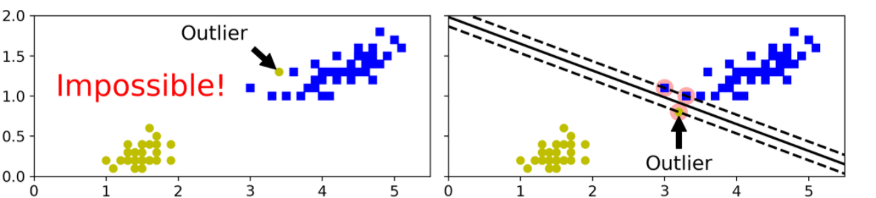
Hard vs. Soft Margin Classification
Hard margin classification: all instances must be off the street and on the right side

Slide 12
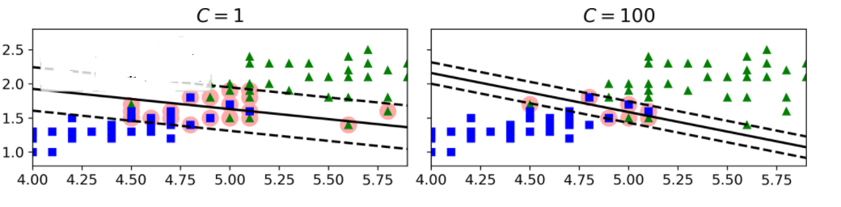
Hard vs. Soft Margin Classification
Soft margin classification: finding a good balance between keeping the street as large as possible and limiting the margin violations
Hyperparameter C: the larger the C, the harder margin it becomes

Slide 13
Comparing Automated Text Classification Methods
Hartmann et al. (2019) International Journal of Research in Marketing
https://www.sciencedirect.com/science/article/pii/S0167811618300545
Many marketing applications require structuring this data at scales e.g., to detect communication shifts in sentiment or other researcher-defined content categories.
To automatically classify unstructured text using ML methods (e.g., Random forests, Support Vector Machines, and dictionary based)
Using 41 different social media datasets covering different sample sizes, languages, and platforms.
Showing that no single method performs equally well across all application settings

Slide 14
SVM
Pros
Cons
Categorical or continuous target variable
Feature-to-row ratio is very high
Very complex relationships
Lots of outliers
Feature-to-row ratio is very low
Transparency is important or interested in significance of predictors
Looking for a quick benchmark model

Slide 15
Run Linear SVM
Make use of Pipeline function from sklearn
Combining steps together
from sklearn.pipeline import Pipeline
from sklearn.preprocessing import StandardScaler
from sklearn.svm import LinearSVC
SVM_clf = Pipeline([
("scaler", StandardScaler(with_mean=False)),
("linear_svc", LinearSVC(C=1, loss="hinge")),
])
SVM_clf.fit(x_train, y_train)

Slide 16
Model Evaluation
 | Error rate | Sensitivity | Specificity | Precision | AUC
SVM | 0.214286 | 0.823529 | 0.75 | 0.756757 | 0.875
Hard Margin Classification: Change hyperparameter c from 1 to 50
 | Error rate | Sensitivity | Specificity | Precision | AUC
SVM | 0.214286 | 0.764706 | 0.805556 | 0.787879 | 0.871732

Slide 17
Feature Importance
SVM | Feature importance
Q5_2 | 0.76261089,
Q5_3 | -0.10301142,
Q5_4 | 0.09992458
Q5_5 | 0.21804102
Q5_6 | -0.05551437
Q5_7 | -0.18371202,
Q5_8 | 0.42033796,
Q5_9 | 0.07928
Boosting Feature importance
0.244268
0.085783
0.070811
0.271757
0.047562
0.05547
0.141423
0.082926
Random forest feature importance
0.221445
0.071668
0.114795
0.232877
0.064925
0.077191
0.139245
0.077854
Logit model coefficients
0.519509
0.063834
-0.08723
0.183154
-0.07961
-0.10728
0.225757
-0.00966
from sklearn import svm
svm = svm.SVC(kernel='linear',max_iter=10000000)
svm.fit(x_train,y_train)
svm.coef_

Slide 18
SVM Multi-Class DV
from sklearn.pipeline import Pipeline
from sklearn.preprocessing import StandardScaler
from sklearn.svm import LinearSVC
SVM_clf = Pipeline([
("scaler", StandardScaler(with_mean=False)),
("linear_svc", LinearSVC(C=1, loss="hinge",max_iter=1000000)),
])
SVM_clf.fit(x_train, y_train)

Slide 19
SVM Multi-Class Prediction
Respondent | y_test | y_pred
1 | 7 | 5
2 | 7 | 7
3 | 7 | 7
4 | 6 | 7
5 | 7 | 7
6 | 6 | 7
7 | 4 | 5
8 | 7 | 7
9 | 5 | 5
10 | 5 | 5
11 | 7 | 7
12 | 5 | 3
13 | 4 | 5
14 | 6 | 7
15 | 5 | 6
16 | 7 | 7
17 | 6 | 7
18 | 7 | 7
19 | 6 | 7
20 | 6 | 7
21 | 7 | 7
22 | 6 | 7
23 | 5 | 7
y_pred=SVM_clf.predict(x_test)
error_rate=1-SVM_clf.score(x_test,y_test)
error_rate
0.48571428571428577

Slide 20
SVM Continuous DV
from sklearn.pipeline import Pipeline
from sklearn.preprocessing import StandardScaler
from sklearn.svm import SVR
SVR = Pipeline([
("scaler", StandardScaler(with_mean=False)),
('svr', SVR(epsilon=0.2)),
])
SVR.fit(x_train, y_train)

Slide 21
SVM Continuous Y: Value Prediction
Respondent | y_test | y_pred | y_pred_reg
1 | 7 | 5 | 4.898182
2 | 7 | 7 | 6.012666
3 | 7 | 7 | 6.673026
4 | 6 | 7 | 5.839693
5 | 7 | 7 | 6.643603
6 | 6 | 7 | 6.928679
7 | 4 | 5 | 4.712188
8 | 7 | 7 | 6.73979
9 | 5 | 7 | 4.704715
10 | 5 | 7 | 5.334243
11 | 7 | 7 | 6.675396
12 | 5 | 5 | 5.094732
13 | 4 | 5 | 5.593758
14 | 6 | 7 | 6.606025
15 | 5 | 6 | 5.284378
16 | 7 | 7 | 6.939705
17 | 6 | 7 | 6.777427
18 | 7 | 7 | 6.882776
19 | 6 | 7 | 4.944276
20 | 6 | 7 | 6.475189
21 | 7 | 7 | 6.528171
22 | 6 | 7 | 6.123639
23 | 5 | 7 | 6.128615
y_pred_reg=SVR.predict(x_test)
R2=SVR.score(x_test,y_test)
0.38841116582259505

Slide 22
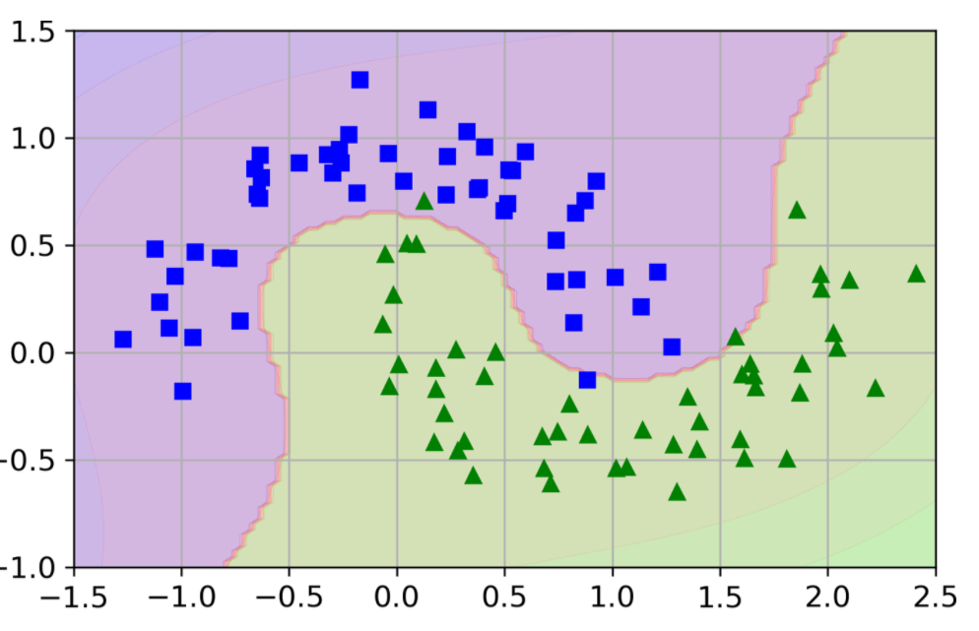
Non-linear SVC
Many datasets are not even close to being linearly separable.

Slide 23
Non-linear SVC
Polynomial kernel
The kernel trick (or kernel method)
Transform data that is not linearly separable in n-dimensional space to a higher dimension where it is linearly separable.
from sklearn.svm import SVC
poly_kernel_svm_clf = Pipeline([
("scaler", StandardScaler()),
("svm_clf", SVC(kernel="poly", degree=3, coef0=1, C=5)) ])
poly_kernel_svm_clf.fit(X, y)

Slide 24
Model Evaluation
 | Error rate | Sensitivity | Specificity | Precision | AUC
SVM (non-linear) | 0.257143 | 0.764706 | 0.722222 | 0.722222 | 0.818627
 | Error rate | Sensitivity | Specificity | Precision | AUC
SVM (linear) | 0.214286 | 0.823529 | 0.75 | 0.756757 | 0.875

Slide 25
ML Model Selection
Logit, Random Forests, Gradient Boosting or Support Vector Machine
Target variable is continuous
Random Forests, Gradient Boosting or Support Vector Machine
Need to know the specific impact of a feature on outcome
Logit, Support Vector Machine
Need to statistical significance of a feature’s impact
Logit
Prediction accuracy

Slide 26
ML Model Selection – Prediction Accuracy
 | Error rate | Sensitivity | Specificity | Precision | AUC | Cross-Entropy
Logistic | 0.242857 | 0.735294 | 0.777778 | 0.757576 | 0.843954 | 0.488734
 | Error rate | Sensitivity | Specificity | Precision | AUC
SVM | 0.257143 | 0.764706 | 0.722222 | 0.722222 | 0.818627
XG Boost Original | 0.328571 | 0.676471 | 0.666667 | 0.657143 | 0.797386 | 0.897337
Random Forest | 0.285714 | 0.705882 | 0.722222 | 0.705882 | 0.838235 | 0.499165

Slide 27
Improve Prediction Accuracy
Add more variables e.g., use frequency and length
 | Error rate | Sensitivity | Specificity | Precision | AUC | Cross-Entropy
Logistic | 0.257143 | 0.833333 | 0.675 | 0.657895 | 0.83 | 0.525791
SVM | 0.242857 | 0.833333 | 0.7 | 0.675676 | 0.799167
XG Boost | 0.271429 | 0.794118 | 0.666667 | 0.692308 | 0.804739 | 0.944369
Random Forest | 0.314286 | 0.705882 | 0.666667 | 0.666667 | 0.824346 | 0.508355

